Slide 1
Dynamic Programing
Algorithm | CSE231
Rizwan Shariare Shopno ID: 221-15-5788 Sec: 61_H Dept. of CSE Daffodil International University
Submitted to,
MHS Lecturer Dept. of CSE Daffodil International University

Slide 2
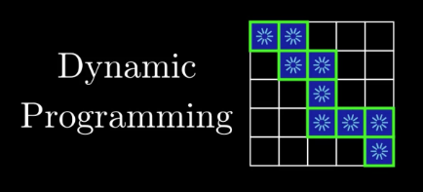
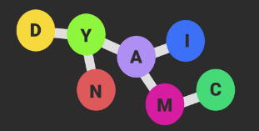
Introduction
Definition: Dynamic Programming is an algorithmic optimization technique that solves complex problems by breaking them into simpler overlapping subproblems.
Importance: Widely used in optimization, resource allocation, and sequence alignment.

Slide 3
Overview
Key Terms
Dynamic Programming involves breaking down problems into subproblems, solving each subproblem once, and storing solutions for future use.
Optimal Structure
Overlapping Subproblems
State
Recurrence Relation
Memoization
Tabulation
Bottom-Up Approach

Slide 4





Basic Foundation
State Comparing
Time Complexity
Analysis
Search
Interact

Slide 5
Components and Effects
State
Recurrence Relation
Tabulation
Advantages
Improved Time Complexity
Efficient Problem Solving
Challenges
Space Complexity
Choosing Between Memoization and Tabulation

Slide 6
Conclusion
Dynamic Programming is a versatile and powerful technique in algorithmic problem-solving. It provides optimal solutions to a variety of problems by breaking them down into manageable subproblems.

Slide 7
Thank You

